Slide 1
Contractor Safety Stand-down
“Together making a visible safety difference”
September 2018
Presenter: Dr Pat Mazibuko

Slide 2
Background
HAVE PERSONAL INTEREST IN YOUR HEALTH, SAFETY AND WELL-BEING
Reason for the stand down ( unfortunate eventuality)
Cross Connect (Openserve Contractor) recently lost an employee whilst performing his duties and a preliminary investigation has been conducted for the incident. Sequence of events before and after the incident don’t tie up!
Cause for concern :
Telkom and its partners (SPs) cannot afford to send any employee at home in a coffin without any clear accountability. This is not our BUSINESS!
Changes in Telkom’s operating model
Use of contractors doesn’t abdicate our responsibility as the primary employer. There has been notable changes within Telkom environment and this has resulted in a significant increase in the use of contractors.
Risks and responsibilities
A clear call for all of us to partner in our endeavors of delivering safely, discharging our duties safely! Not only should we as a collective believe that all incidents are preventable but our actions must demonstrate that.

Slide 3
What can we do to ensure we are working together to make a difference?
Plan for the Safe Execution of our jobs and fulfill the BASICS
Know the OHS requirements (legal requirements & implications for non-compliance).
Legal Requirement: 37.2 agreement
What is 37.2 agreement?
It is a legal OHS agreement between a Client and a Principle Contractor
Why do we need 37.2 agreement?
To ensure compliance by Principal Contractor
The importance of signing 37.2 agreement?
If it is not signed legally it is not valid
What are the implications of the absence of the agreement?
Any Act or Omission by a Contractor would be taken as if it were committed by the Client

Slide 4
What can we do to ensure we are working together to make a difference…………
Legal requirement 2: COID
Compensation for Occupational Injuries & Disease Act (Register your company )
Legal requirement 3: Training
Employees are not supposed to execute any work if untrained.
Legal requirement 4: Risk assessment
No work must be executed without a HIRA
Legal requirement 5: Provision of PPE
One of the many Controls to mitigate risks

Slide 5
Expectations Going Forward
Key Take Home Points
Consistently and faithfully use of PPE provided to reduce exposure
Take personal accountability and responsibility for your own safety
Have total regard for SOPs
Invest time in conducting Specific Risk Assessment, it’s your life after all! (Baseline risk assessment is for compliance purposes)
Share good practices with one another
Local management ( SP & Telkom) to provide clear oversight on safety operations and risk assessments
Incident Cause
Any sub-standard act and condition:
Deviation from procedures?
Unsafe environment?
Human factors:
Inability to identify prevalent risk?
Workplace factors:
Inadequate knowledge and training?
Emergency handling factors:
How do we trigger help during unfortunate eventualities?
Incident scene management:
Secure the incident scene till authorities arrive
Secure evidence digitally where possible

Slide 6
Background - Changing the culture: Zero is attainable!
3
Telkom ranked amongst the top 20 most dangerous companies to work for in FY 16/17, although in FY17/18 there has been a significant improvement in Telkom’s safety performance.
In the FY 17/18 Telkom had 2 Third Party fatalities, 2 employee fatalities, 2 employee deaths ( recordable but not reportable) – all linked to motor vehicle accidents.
By implementing a systematic approach to manage Health, Safety and Environment, we will achieve and sustain world class performance and create a culture where everyone believes that incidents are preventable.
Healthier and safer employees contribute towards improved performance and thus competitive advantage.
This calls for a compelling case for change!
Leadership Accountability and commitment
Systematic Management of HSE
Improved safety culture and performance

Slide 7
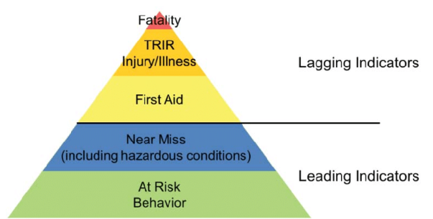
Root causes – Why?
8
Previously the focus has been on compliance rather than improving safety performance
No appropriate corrective actions taken on risk assessments and investigation outcomes
Procedures not being followed and taking short-cuts
Management positively re-enforcing unsafe behaviours
Operational and safety statutory training not done due to budget constraints
Lack of consequence management model
Lack of leadership oversight at all levels
Lowlights:
FY 17/18 – 6 MVA related fatalities ( 2 third party, 4 employees)
Although MVA counts for 10% of IOD stats – severity and the impact is high ( one death is one too many)

Slide 8
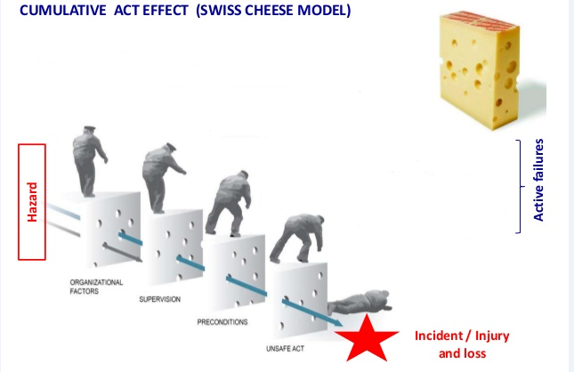
Telkom’s safety performance – Why?
9
Latent failures
Organisational factors: Culture, decisions made
Lack of supervision: communication failure,
-unrealistic targets, re – enforcing unsafe behaviours
Inadequate controls, fatigue, disengaged workforce
Taking short cuts, not following procedures,
Behavioural issues, Lack of skills/knowledge
Sweese cheese accident causation model:
Risk is mitigated by different layers of protection
Failure or flaws in each layer creates a single point of failure and allow accidents to occur
Failure in all layers of protection have resulted in the current safety record for Telkom
This calls for a compelling case for change!

Slide 9
Quick Wins
15
Classification | Action | Benefits | Responsible
Motor Vehicle Safety | Institute defensive driving for high exposure drivers and computer based training for non high exposure drivers | Prevent motor vehicle accidents Reduce insurance claims Promote good driver behaviour | Management
 | Re-enforce the use of driver GYR dashboard and take appropriate action | Allows management to act on lead indicators Prevents motor vehicle accidents Re-enforce driver behaviour | Management
 | Drive with headlights on 24/7 | See to be seen Prevent head-on collisions | All
 | Declare all Telkom facilities as “reverse park” site | Ease of evacuation Prevents parking incidents Displays a visible safety culture | Telkom employees, visitors and contractors
Safe Operations | Entrench adherence to SOP’s e.g. working at heights, confined space entry and ensure usage of proper tools/equipment institute appropriate consequence management | Reduce gravity related incidents (40% IOD incidents due to gravity | Management
 | Management to communicate “right of refusal to lawful instruction under unsafe working conditions” | Employees not exposed to unnecessary risks/hazards Employees understanding their rights of Safety Instill operational discipline | Management
 | Bee and Wasp sting hyper sensitivity testing | Helps employees to know their allergens Encourage people to carry appropriate prophylactic treatment | Technicians

Slide 10
Quick Wins
16
Classification | Action | Benefits | Responsible
Visible Leadership, Accountability and Commitment Safe Operations | Incorporate safety KPI’s in performance contracts | “ What gets measured, gets done” Safety tone at a leadership level | Management
 | Implement Stop Work Authority (SWA) | Proactive prevention of safety incidents Drive safety as everyone’s responsibility | All
 | Monthly Exco safety walk-abouts | Display of top leadership commitment on safety Leadership sets the right safety tone as a collective Embedment of a visible safety culture | Exco and senior management
 | Quarterly BU assurance forums | Exco oversight on Safety performance Use quarterly reviews to afford Exco PDCA Re-enforce and re-entrenche safety culture leading to safety excellence Drive a fully integrated safety culture Act as a safety governance process | Management
 | Start every meeting with a safety moment Safety conversation Ethics conversation | Reinforce the safe behaviour needed to do the job safely. Create greater safety awareness through specific focused safety reminders. Allow opportunities to give information and follow-up on new safety rules and regulations | All
 | Revise travel policy to incorporate safety and security measures and principles | Minimize risk of Executives being involved in an incident at the same time | HR
Engaged Workforce | Bi-annual safety stand-down ( Led by senior management) One hour stand-down for all major incidents (Fatalities) | Incident recall to facilitate organizational learning Immediate sharing of lessons learnt and prevention of reoccurrences | Senior Management

Slide 11
Telkom Safety Golden Rules ( addressing top 5 risks)
15
17
All Telkom employees, contractors, and visitors are required to always:
1. Observe safe work procedures of these high-risk activities that could result in a serious accident
  Working at heights, including use of ladders
  Always protect yourself from falling when working at heights.
  Never improperly use ladders or scaffolds.
  Always use fall protection equipment and personal protective equipment (PPE) when working at heights
  Confined Space entry and manholes
  Always do gas testing and to confirm that it is safe to enter a confined space.
  Always use proper equipment to open manholes.
  Motor Vehicle safety
  Always wear seat-belt when driving own vehicle, company-owned vehicles and/or on company business.
  Never use cellphone while driving
  Always drive with your headlights on to improve visibility
2. Understand the hazards of each job and use proper personal protective equipment (PPE) every time
  Never start a job without first identifying the safety hazards,
  Never perform work requiring PPE without using the appropriate equipment each and every time.
3. Engage in activities you are fully trained to perform, follow procedures, and obey safety rules and signs ( Permit to work)
4. Report hazards, work-related injuries and near misses immediately to your promoter and the OHS consultant.

Slide 12
Conclusion
Implement the “QUICK WINS” as defined in the Baseline Safety Strategy
Drive heightened safety awareness aggressively and have consequences for non-compliance
Stick to the defined basics. If not clear, consult!
This message must hit home , can’t afford to reconfigure somebody else’s life for the worst!
Promise yourself that never again will anyone of us go back home in a coffin under your watch!
No operating condition , or urgency of service that justifies one endangering the life of anyone or causing an injury

